Slide 1
WiLD NET
ICTD fall 2010
(Wifi-based long distance network)
2010SIY7501 Roh Jaekeun

Slide 2
INDEX
What is the WiLD Net?
Why the WiLD Net?
Technical things
Present of WiLD Net
Potential problems
Epilogue

Slide 3
What is the WiLD Net?
Wifi-based Long Distance Nerwork
WiFi could cover 50 ~ 100 Km, while WiLD Net could cover more than 300 Km
802.11 standard
Anywhere, anytime
Notes:
WiLD Net stands for Wifi-based Long Distance Nerwork
Traditional approach to using wireless internet cover small area maximum 100 Km, but WiLD Net cover more than 300 Km
802.11 standard, WiFi.
It makes possible to using internet everywhere in the city and rural area also

Slide 4
Why the WiLD Net?
Low cost
High bandwidth
Long Distance
Notes:
In the saying WiLD Net, we should remember these three things.
Low cost, High bandwidth, Long distance.
Those are the main issue of WiLD net technology.
Low cost could be said again as low power.
High bandwidth could be rephrase high data rate( bps)
The picture shows it is not happen in reality. Because in rural area such as non-developed is not good circumstance to use mobile network. If you can, it will be very expensive. There’s no base station, or less. You should install your own BST for using mobile phone,
And it will be worked only in limited area.

Slide 5
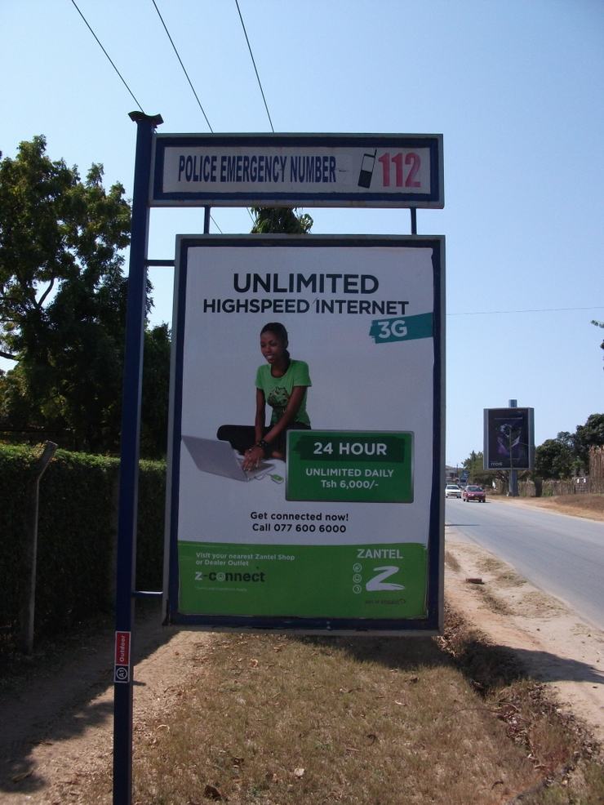
Why the WiLD Net? (cont.)
Money-based
“the rich get richer,
the poor get poorer”
Open Information
Notes:
Reality reign over the money-based system
There’er saying “the rich get richer, the poor get poorer “ it will happen exactly same in the information area.
Reality makes polarization phenomenon about the information area also which is open to everybody.
Even if there’s technology, but have no money will drives you to connectionless life.
You can see the picture, it is somewhere in Africa, and they provide 3G service.
All information should be shared if it is a good information

Slide 6
Technical things
Basic Problem in 802.11( Wi-Fi )
Low utilization
Collisions at long distances
Inter-link interference
Notes:
(a) low utilization,
(b) collisions at long distances
(c) inter-link interference.
(a)To address the problem of low utilization, we propose the use of bulk packet acknowledgments
(b)To mitigate loss from collisions at long distances as well as inter-link interference, we replace the
standard CSMA MAC with a TDMA-based MAC protocol. We build upon 2P to adapt it to high-loss
environments
(c) to handle the challenge of high and variable packet losses, we design adaptive loss recovery
mechanisms that use a combination of FEC and retransmissions with bulk acknowledgments
We will discuss about these little bit more from the next slide

Slide 7
Technical things (cont.)
Performance of WiLD Net
Beyond the 110 Km(the maximum possible ACK time out)
Effective collision handling
Good loss toleration
Notes:
It demonstrate the ability of WiLDNet. to eliminate link under-utilization and packet collisions
over a single WiLD link. We compare the performance of WiLDNet (slot size of 20ms) with the standard 802.11
CSMA (2 retries) base case. The first set of results show the improvement of WiLDNet on a single emulator link
with increasing distance.
Figure 9(a) compares the performance of TCP flowing only in one direction. The lower throughput of WiLDNet,
approximately 50% of channel capacity, is due to symmetric slot allocation between the two end points of the
link. However, over longer links (>50 km), the TDMA based channel allocation avoids the under-utilization of
the link as experienced by CSMA. Also, beyond 110 km (the maximum possible ACK timeout), the throughput
with CSMA drops rapidly because of unnecessary retransmits.
Figure 9(b) shows the cumulative throughput of TCP flowing simultaneously in both directions. In this case,
WiLDNet effectively eliminates all collisions occurring in presence of bidirectional traffic.
TCP throughput of 6 Mbps is maintained for all distances. Table 1 compares WiLDNet and CSMA for some of
our outdoor wireless links. We show TCP throughput in one direction and the cumulative throughput for TCP simultaneously
flowing in both directions. Since these are outdoor measurements, there is significant variation over
time and we show both the mean and standard deviation for the measurements. We can see that as the link distance increases, the improvement of WiLDNet is more substantial. In fact, for the 65 km link in Ghana,
WiLDNet’s throughput at 5.5Mbps is about 8x better than standard CSMA.

Slide 8
Present of WiLD Net(cont.)
India (the Aravind network : Using relay)
Notes:
The Aravind network at Theni consists of five vision centers connected to the main hospital in Theni (Figure 2).
The network has total of 11 wireless routers (6 endpoints, 5 relay nodes) and uses 9 point-to-point links. The links
range from just 1 km (Theni - Vijerani) to 15 km (Vijerani - Andipatti). Six of the wireless nodes are installed
on towers, heights of which range from 24–42m; the others use short poles on rooftops or existing tall structures,
such as the chimney of a paper factory. Recently, Aravind has expanded this model to their hospitals in Madurai
and Tirunalveli where they have added two vision centers each using a total of five point-to-point links. The
network is financially viable with a planned expansion to 50 clinics around 5 hospitals, which will provide access
to eye care for 2.5M people.
Hardware: The wireless nodes are 266-MHz x86 single board
computers. They run a stripped-down version of Linux 2.4.26 stored on a 512 MB CF card. The routers
can have up to 3 high-power Atheros 802.11 a/b/g radio cards (200mW). The longer links use 24dBi directional
antennas. The routers consume about 4.5W when idle and 9.5W when transmitting at full bandwidth from 2
radios; 7Wis the average power consumption for a node. We also run software for routing, logging and monitoring
on the routers. The routers are small and lightweight (less than 10 pounds), so we place them in water-proof enclosures
and mount them near the antenna, typically on the same pole. This allows us to minimize the signal loss between
the antenna and the radio. The routers are powered via power-over-ethernet (PoE), which allows a single cable
from the ground to the router. We use uninterruptible power supplies (UPSs) to provide clean power, although
we discuss solar power in Section 5.2.
Applications: The primary application is video conferencing
and we currently use software from Marratech [17]. Although most conferences are doctor-patient,
we also use it for remote training.We chose this software in part because it was easy for the staff to use. The typical
throughputs on the links range between 5–7 Mbps with channel loss less than 2%. However, 256 Kbps in each
direction is sufficient for very good quality videoconferencing. Our network is thus over-provisioned for the pilot
phase.We also use the network to transmit diagnostic images taken with a digital camera that has been modified
to connect to the slit lamp. There are also a range of standard e-mail and office applications. The hospital
has a VSAT link to the Internet, but most of these applications only intranet access within the network
(except for remote management). Analysis of the traffic logs from last 12 months shows that each vision center
has received 160 GB and transmitted 40 GB of mostly video traffic.

Slide 9
Present of WiLD Net(cont.)
India (the Airjaldi network : Using directional antenas)
Notes:
The AirJaldi network currently provides fast Internet access and VoIP telephony services to about 10,000 users
at a radius of over 70 km in a rural mountainous terrain characterized by extreme weather. The network has 8
long distance directional links ranging from 10 km to 41 km with 10 endpoints. In addition, the network also has
over hundred low-cost modified consumer access points that use a wide array of outdoor antennas. Three of the
nodes are solar-powered, relay stations at remote elevated places with climbable towers. All other antennas
are installed on short (less than 5m) low-cost masts, typically water pipes, on the roof tops of subscribers.
Hardware: Most of the routers are extracted from consumer
devices, either Linksys WRT54GL or units from Buffalo Technologies, and cost less than US$50. They
are housed inside locally designed and built weatherproof enclosures, and aremounted next to the antennas in
order to minimize signal loss over the otherwise longer RF cables. The antennas, power supplies and batteries
are all manufactured locally in India. The router boards are built around a 200MHz MIPS processor with 16MB
of RAM and 4MB of on-board flash memory with a lowpower Broadcom 802.11b/g radio.We run a rudimentary
Linux flavor called OpenWRT based on BusyBox. For long-distance links and major relay stations we also use
slightly higher-end devices such as PCEngines WRAP boards, MikroTik routerboards and Ubiquiti LS2s with
Atheros-based radios. The routers use open-source software for mesh routing, encryption, authentication, QoS,
remote management and logging.
Applications: The Internet uplink of AirJaldi consists of
5 ADSL lines ranging from 144 Kbps to 2 Mbps to have a total of about 7 Mbps downlink and 1 Mbps uplink
bandwidth. In the wireless network, the longest link from TCV to Ashapuri (41 km) achieves a throughput of about
4–5Mbps at less than 2–5%packet loss, but the link from TCV to Gopalpur (21 km) only gets about 500–700Kbps
at 10–15% loss due to the absence of clear line of sight. This bandwidth is sufficient for applications such as Internet
access and VoIP that cater to the primary needs of the Tibetan community-in-exile surrounding Dharamsala,
namely schools, hospitals, monasteries and other non-profit organizations. A cost-sharing model is used
among all network subscribers to recover operational costs. The network is also now financially sustainable
and growing fast. There are currently over 2200 unique MAC addresses on the network, which are mostly computers
shared by a number of users daily. AirJaldi only provides connectivity to fixed installations that interconnect
LANs of various organizations and does not offer wireless access to roaming users or mobile devices.

Slide 10
Potential Problems
Cultural challenge in rural area
Staff and Training
Power problems
Tampering and theft
Corruption
Illiteracy
Notes:
First local staff tend to start with limited knowledge about wireless networking and IT systems. This leads to limited diagnostic capabilities, inadvertent equipment misuse, and misconfiguration. Thus management tools need to help with diagnosis and must
be educational in nature. Training helps as well, but high IT turnover limits the effectiveness, so education must be ongoing and part of the process.
Second, the chances of hardware failures are higher as a result of poor power quality and a harsh environment
(e.g. lightning, heat, humidity, or dust). Although we do not have conclusive data about the failure rate of equipment
for power reasons in rural areas, we have lost far more routers and adapters for power reasons in rural India
than we have lost in our Bay Area test bed. This calls for a solution that provides stable, high-quality power to
equipment in the field.
Third, many locations with wireless nodes, especially relays, are quite remote. It is important to avoid unnecessary visits to remote locations. Also, we should enable preventive maintenance during the visits that do occur. For example, gradual signal strength degradation could imply cable replacement or antenna realignment during a normal visit.
Fourth, the wireless deployment may often not be accessible remotely or through the Internet. The failure of
a single link might make parts of network unreachable, even if the nodes themselves are functional. This makes
it very hard for remote experts in another town or even local administrators to resolve or even diagnose the problem.

Slide 11
Epilogue
Upcoming Technology for the public
Government need to having some actions to support.
Information Era will blossom through WiLD Net

Slide 12
Thank you all

